Slide 1
Other SQL Constraints

Slide 2
SQL Constraints
SQL constraints are used to specify rules for the data in a table.
If there is any violation between the constraint and the data action, the action is aborted by the constraint.
Constraints can be specified when the table is created (inside the CREATE TABLE statement) or after the table is created (inside the ALTER TABLE statement).
SQL CREATE TABLE + CONSTRAINT Syntax
CREATE TABLE table_name ( column_name1 data_type(size) constraint_name, column_name2 data_type(size) constraint_name, column_name3 data_type(size) constraint_name, .... );

Slide 3
In SQL, we have the following constraints:
NOT NULL - Indicates that a column cannot store NULL value
UNIQUE - Ensures that each row for a column must have a unique value
PRIMARY KEY - A combination of a NOT NULL and UNIQUE. Ensures that a column (or combination of two or more columns) have an unique identity which helps to find a particular record in a table more easily and quickly
FOREIGN KEY - Ensure the referential integrity of the data in one table to match values in another table
CHECK - Ensures that the value in a column meets a specific condition
DEFAULT - Specifies a default value when specified none for this column

Slide 4
SQL NOT NULL Constraint
By default, a table column can hold NULL values.
The NOT NULL constraint enforces a column to NOT accept NULL values.
The NOT NULL constraint enforces a field to always contain a value.
This means that you cannot insert a new record, or update a record without adding a value to this field.
The following SQL enforces the "P_Id" column and the "LastName" column to not accept NULL values:
Example
CREATE TABLE Persons ( P_Id int NOT NULL, LastName varchar(255) NOT NULL, FirstName varchar(255), Address varchar(255), City varchar(255) )

Slide 5
SQL UNIQUE Constraint
The UNIQUE constraint uniquely identifies each record in a database table.
The UNIQUE and PRIMARY KEY constraints both provide a guarantee for uniqueness for a column or set of columns.
A PRIMARY KEY constraint automatically has a UNIQUE constraint defined on it.
Note: you can have many UNIQUE constraints per table, but only one PRIMARY KEY constraint per table.
SQL UNIQUE Constraint on CREATE TABLE
The following SQL creates a UNIQUE constraint on the "P_Id" column when the "Persons" table is created:
CREATE TABLE Persons ( P_Id int NOT NULL UNIQUE, LastName varchar(255) NOT NULL, FirstName varchar(255), Address varchar(255), City varchar(255) )

Slide 6
SQL UNIQUE Constraint on ALTER TABLE
To create a UNIQUE constraint on the "P_Id" column when the table is already created, use the following SQL:
ALTER TABLE Persons ADD CONSTRAINT uc UNIQUE (P_Id)
To DROP a UNIQUE Constraint
To drop a UNIQUE constraint, use the following SQL:
ALTER TABLE Persons DROP CONSTRAINT uc

Slide 7
SQL PRIMARY KEY Constraint
The PRIMARY KEY constraint uniquely identifies each record in a database table.
Primary keys must contain UNIQUE values.
A primary key column cannot contain NULL values.
Most tables should have a primary key, and each table can have only ONE primary key.
SQL PRIMARY KEY Constraint on CREATE TABLE
The following SQL creates a PRIMARY KEY on the "P_Id" column when the "Persons" table is created:
CREATE TABLE Persons ( P_Id int NOT NULL PRIMARY KEY, LastName varchar(255) NOT NULL, FirstName varchar(255), Address varchar(255), City varchar(255) )

Slide 8
SQL PRIMARY KEY Constraint on ALTER TABLE
To create a PRIMARY KEY constraint on the "P_Id" column when the table is already created, use the following SQL:
ALTER TABLE Persons ADD CONSTRAINT pk PRIMARY KEY (P_Id)
Note: If you use the ALTER TABLE statement to add a primary key, the primary key column(s) must already have been declared to not contain NULL values (when the table was first created).
To DROP a PRIMARY KEY Constraint
To drop a PRIMARY KEY constraint, use the following SQL:
ALTER TABLE Persons DROP CONSTRAINT pk

Slide 9
SQL FOREIGN KEY Constraint
A FOREIGN KEY in one table points to a PRIMARY KEY in another table.
Let's illustrate the foreign key with an example. Look at the following two
tables:
The "Persons" table:
P_Id | LastName | FirstName | Address | City
1 | Hansen | Ola | Timoteivn 10 | Sandnes
2 | Svendson | Tove | Borgvn 23 | Sandnes
3 | Pettersen | Kari | Storgt 20 | Stavanger
The "Orders" table:
O_Id | OrderNo | P_Id
1 | 77895 | 3
2 | 44678 | 3
3 | 22456 | 2
4 | 24562 | 1

Slide 10
Note that the "P_Id" column in the "Orders" table points to the "P_Id" column in the "Persons" table.
The "P_Id" column in the "Persons" table is the PRIMARY KEY in the "Persons" table.
The "P_Id" column in the "Orders" table is a FOREIGN KEY in the "Orders" table.
The FOREIGN KEY constraint is used to prevent actions that would destroy links between tables.
The FOREIGN KEY constraint also prevents invalid data from being inserted into the foreign key column, because it has to be one of the values contained in the table it points to.

Slide 11
SQL FOREIGN KEY Constraint on CREATE TABLE
The following SQL creates a FOREIGN KEY on the "P_Id" column when the "Orders" table is created:
CREATE TABLE Orders ( O_Id int NOT NULL PRIMARY KEY, OrderNo int NOT NULL, P_Id int FOREIGN KEY REFERENCES Persons(P_Id) )
SQL FOREIGN KEY Constraint on ALTER TABLE
To create a FOREIGN KEY constraint on the "P_Id" column when the "Orders" table is already created, use the following SQL:
ALTER TABLE Orders ADD CONSTRAINT fk FOREIGN KEY (P_Id) REFERENCES Persons(P_Id)

Slide 12
To DROP a FOREIGN KEY Constraint
To drop a FOREIGN KEY constraint, use the following SQL:
ALTER TABLE Orders DROP CONSTRAINT fk

Slide 13
SQL CHECK Constraint
The CHECK constraint is used to limit the value range that can be placed in a column.
If you define a CHECK constraint on a single column it allows only certain values for this column.
If you define a CHECK constraint on a table it can limit the values in certain columns based on values in other columns in the row.
SQL CHECK Constraint on CREATE TABLE
The following SQL creates a CHECK constraint on the "P_Id" column when the "Persons" table is created. The CHECK constraint specifies that the column "P_Id" must only include integers greater than 0.
CREATE TABLE Persons ( P_Id int NOT NULL CHECK (P_Id>0), LastName varchar(255) NOT NULL, FirstName varchar(255), Address varchar(255), City varchar(255) )

Slide 14
SQL CHECK Constraint on ALTER TABLE
To create a CHECK constraint on the "P_Id" column when the table is already created, use the following SQL:
ALTER TABLE Persons ADD CONSTRAINT chk CHECK (P_Id>0)
To DROP a CHECK Constraint
To drop a CHECK constraint, use the following SQL:
ALTER TABLE Persons DROP CONSTRAINT chk

Slide 15
SQL AUTO INCREMENT Field
Auto-increment allows a unique number to be generated when a new record is inserted into a table.
Very often we would like the value of the primary key field to be created automatically every time a new record is inserted.
Syntax for SQL Server
The following SQL statement defines the "ID" column to be an auto-increment primary key field in the "Persons" table:
CREATE TABLE Persons(ID int primary key auto_increment, LastName varchar(255) NOT NULL, FirstName varchar(255), Address varchar(255), City varchar(255));
alter table persons auto_increment=5;
insert into persons values(0,'lucy','kats','kig’,’rwa');

Slide 16
The MS SQL Server uses the IDENTITY keyword to perform an auto-increment feature.
In the example above, the starting value for IDENTITY is 1, and it will increment by 1 for each new record.
Tip: To specify that the "ID" column should start at value 10 and increment by 5, change it to IDENTITY(10,5).
To insert a new record into the "Persons" table, we will NOT have to specify a value for the "ID" column (a unique value will be added automatically):
INSERT INTO Persons (FirstName,LastName) VALUES ('Leah','Michael')
The SQL statement above would insert a new record into the "Persons" table. The "ID" column would be assigned a unique value. The "FirstName" column would be set to “Leah" and the "LastName" column would be set to "Michael".

Slide 17
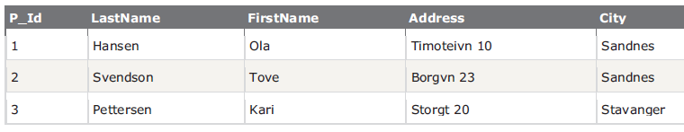
SQL Joins are used to query data from two or more tables, based on a relationship between certain columns in these tables.
The JOIN keyword is used in an SQL statement to query data from two or more tables, based on a relationship between certain columns in these tables.
Tables in a database are often related to each other with keys.
A primary key is a column (or a combination of columns) with a unique value for each row.
Each primary key value must be unique within the table.
The purpose is to bind data together, across tables, without repeating all of the data in every table.
Look at the "Persons" table:

Slide 18
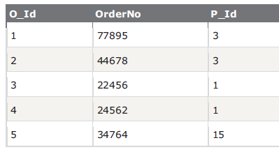
Note that the "P_Id" column is the primary key in the "Persons" table. This means that no two rows can have the same P_Id.
The P_Id distinguishes two persons even if they have the same name.
Next, we have the "Orders" table:
Note that the "O_Id" column is the primary key in the "Orders" table and that the "P_Id" column refers to the persons in the "Persons" table without using their names.
Notice that the relationship between the two tables above is the "P_Id" column.

Slide 19
Different SQL JOINs
Before we continue with examples, we will list the types of JOIN you can use, and the differences between them.
JOIN: Return rows when there is at least one match in both tables
LEFT JOIN: Return all rows from the left table, even if there are no matches in the right table
RIGHT JOIN: Return all rows from the right table, even if there are no matches in the left table
FULL JOIN: Return rows when there is a match in one of the tables

Slide 20
SQL JOIN Keyword
The INNER JOIN keyword returns rows when there is at least one match in both tables.
SQL JOIN Syntax:
SELECT column_name(s)
FROM table_name1
JOIN table_name2
ON table_name1.column_name=table_name2.column_name
Example of SQL INNER JOIN :
SELECT Persons.LastName, Persons.FirstName, Orders.OrderNo FROM Persons JOIN Orders ON Persons.P_Id=Orders.P_Id ORDER BY Persons.LastName
NB: The INNER JOIN keyword returns rows when there is at least one match in both tables. If there are rows in "Persons" that do not have matches in "Orders", those rows will NOT be listed.

Slide 21
SQL LEFT JOIN Keyword
The LEFT JOIN keyword returns all rows from the left table (table_name1), even if there are no
matches in the right table (table_name2).
SQL LEFT JOIN Syntax:
SELECT column_name(s)
FROM table_name1
LEFT JOIN table_name2
ON table_name1.column_name=table_name2.column_name
Example of SQL LEFT JOIN
SELECT Persons.LastName, Persons.FirstName, Orders.OrderNo FROM Persons LEFT JOIN Orders ON Persons.P_Id=Orders.P_Id ORDER BY Persons.LastName
NB: The LEFT JOIN keyword returns all the rows from the left table (Persons), even if there are no matches in the right table (Orders).

Slide 22
SQL RIGHT JOIN Keyword
The RIGHT JOIN keyword returns all the rows from the right table (table_name2), even if there are no
matches in the left table (table_name1).
SQL RIGHT JOIN Syntax:
SELECT column_name(s)
FROM table_name1
RIGHT JOIN table_name2
ON table_name1.column_name=table_name2.column_name
Example of SQL RIGHT JOIN
SQL>SELECT Persons.LastName, Persons.FirstName, Orders.OrderNo
FROM Persons
RIGHT JOIN Orders
ON Persons.P_Id=Orders.P_Id
ORDER BY Persons.LastName
NB: The RIGHT JOIN keyword returns all the rows from the right table (Orders), even if there are no matches in the left table (Persons).

Slide 23
SQL FULL OUTER JOIN Keyword
It returns rows when there is a match in one of the tables.
SQL FULL OUTER JOIN Syntax:
SELECT column_name(s)
FROM table_name1 FULL OUTER JOIN table_name2
ON table_name1.column_name=table_name2.column_name
Example of SQL FULL OUTER JOIN OR FULL JOIN
SQL>SELECT Persons.LastName, Persons.FirstName, Orders.OrderNo
FROM Persons FULL OUTER JOIN Orders
ON Persons.P_Id=Orders.P_Id ORDER BY Persons.LastName;
SQL>SELECT LastName, FirstName, OrderNo FROM Persons FULL JOIN Orders ON Persons.P_Id=Orders.P_Id;
SQL>SELECT LastName, FirstName, OrderNo FROM Persons FULL OUTER JOIN Orders ON Persons.P_Id=Orders.P_Id ORDER BY LastName;
The FULL JOIN keyword returns all the rows from the left table (Persons), and all the rows from the right table (Orders). If there are rows in "Persons" that do not have matches in "Orders", or if there are rows in "Orders" that do not have matches in "Persons", those rows will be listed as well.

Slide 24
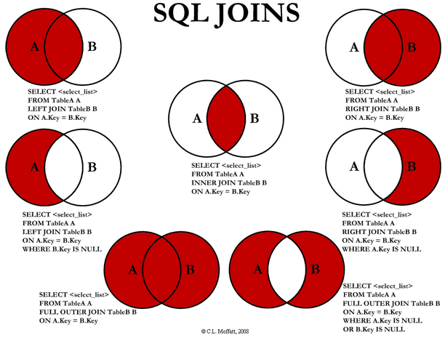

Slide 25
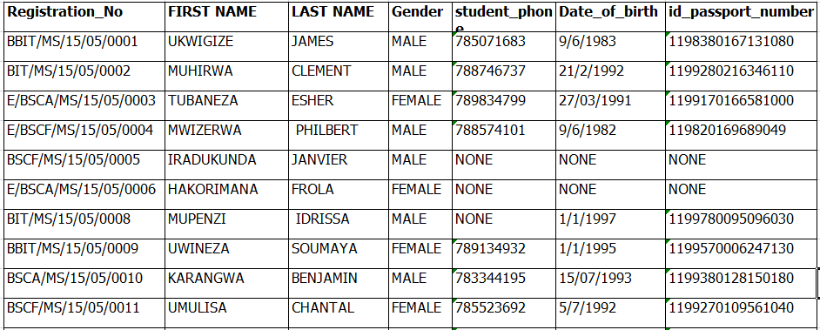
EXERCISES: No1: From the following table below, add a column, delete other different column, use “where” clause and “like , between & IN” operators

Slide 26
EXERCISES:
No1: SQL> create database Student_Records;
SQL > use Student_Records;
SQL > create table Student_Records (reg_no varchar(20) not null primary key, F_name varchar(20), L_name varchar(20),Gender char, PhoneNo int, DOB date, Id_No int;
SQL > desc Student_Records;
SQL > insert into Student_Records (reg_no, F_name, L_name, Gender, PhoneNo, DOB, Id_No) values
('BBIT/MS/15/05/0001','UKWIGIZE ','JAMES','MALE', ‘0785071683', '9/6/1983', '1198380167131080'),
('BIT/MS/15/05/0002','MUHIRWA','CLEMENT','MALE', ‘0788746737', '21/2/1992', '1199280216346110');
SQL > SELECT * FROM Student_Records;
SQL > alter table Student_Records add Department varchar(30);
SQL > alter table Student_Records drop column Gender;
SQL > select reg_no, F_name, L_name from Student_Records where F_name like 'm%' AND DOB='1992';
SQL > SELECT F_name,L_name from Student_Records where reg_no like 'm%' IN ('001','002');

